Slide 1
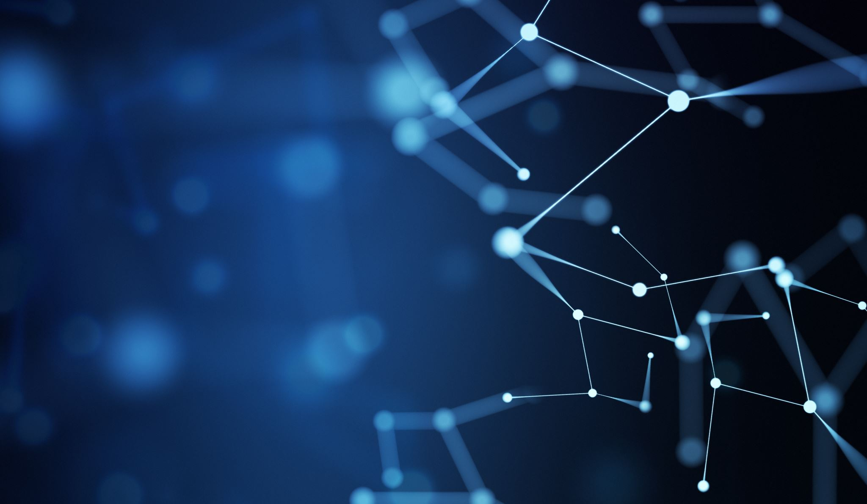
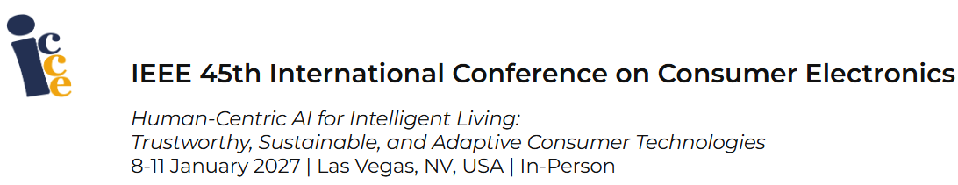

Machine Learning Analysis of Consumer
Electronics-Enabled Passenger Experience
Presented by: Dr. Nour Aburaed
Assistant Professor - College of Engineering and IT

